Slide 1
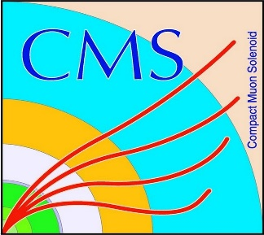

HEP Weekly Report
George Bakas
NTUA

Slide 2
Progress Report
ArdEnvino
sFusion360 tutorial
Analysis
Generate a ttbar MC without spin correlation
Already contacted the conveners of the Top Properties Subgroup
Observables in boosted region (pT > 300, 400 GeV)
DCS
CMSfwAlertSystem
When a user installs this component→ problem is that maybe notifications will be sent
Shut down notifications in non production systems
Main panel bug fixes and new implementations
Batch files that create the DCS projects using installations db
After some fixes new proposal for creating a current project without user interaction (ECAL)

